Slide 1
Sankey diagram
W209 Week 3 - Lin

Slide 2
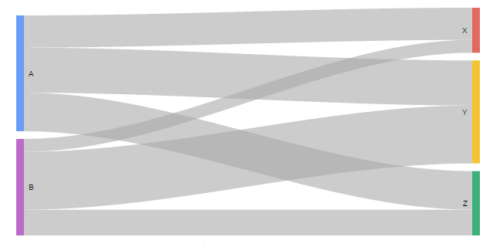
What is Sankey diagram?
A sankey diagram is a visualization used to depict a flow from one set of values to another.
Sankeys are best used when you want to show a many-to-many mapping between two domains (e.g., universities and majors) or multiple paths through a set of stages (for instance, Google Analytics uses sankeys to show how traffic flows from pages to other pages on your web site).

Slide 3
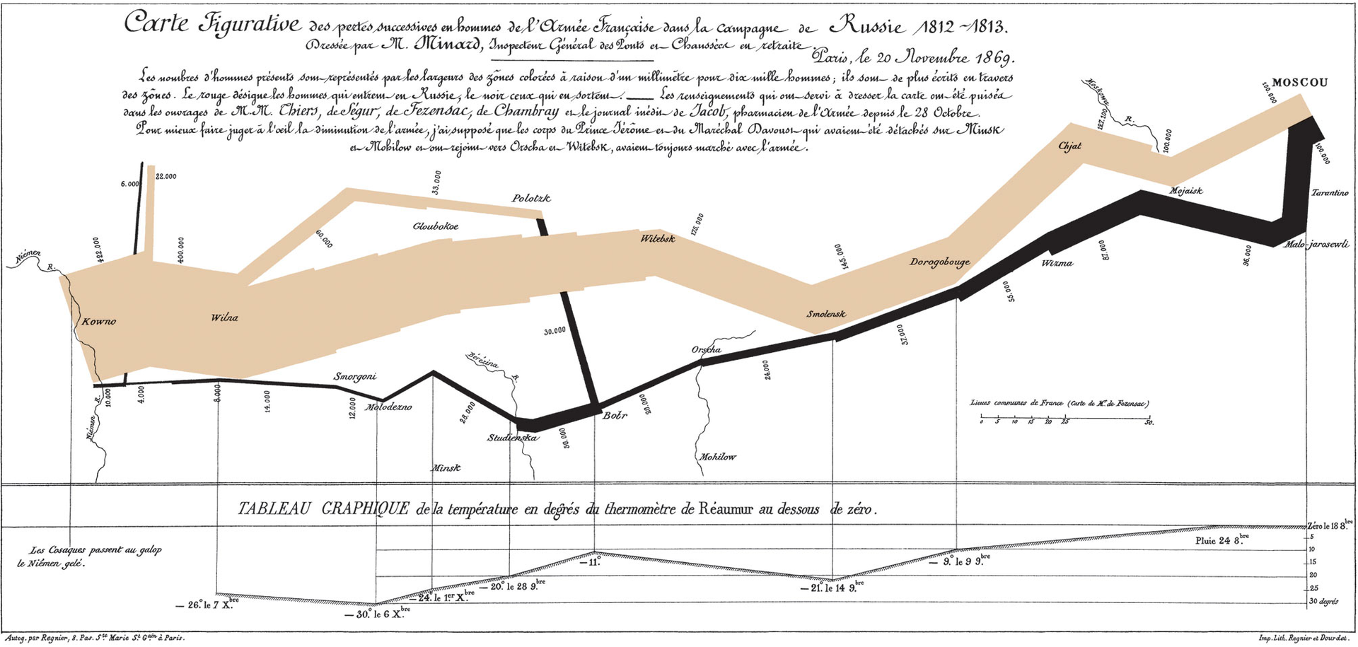
Famous Sankey diagrams
Charles Minard's Map of Napoleon's Russian Campaign of 1812

Slide 4
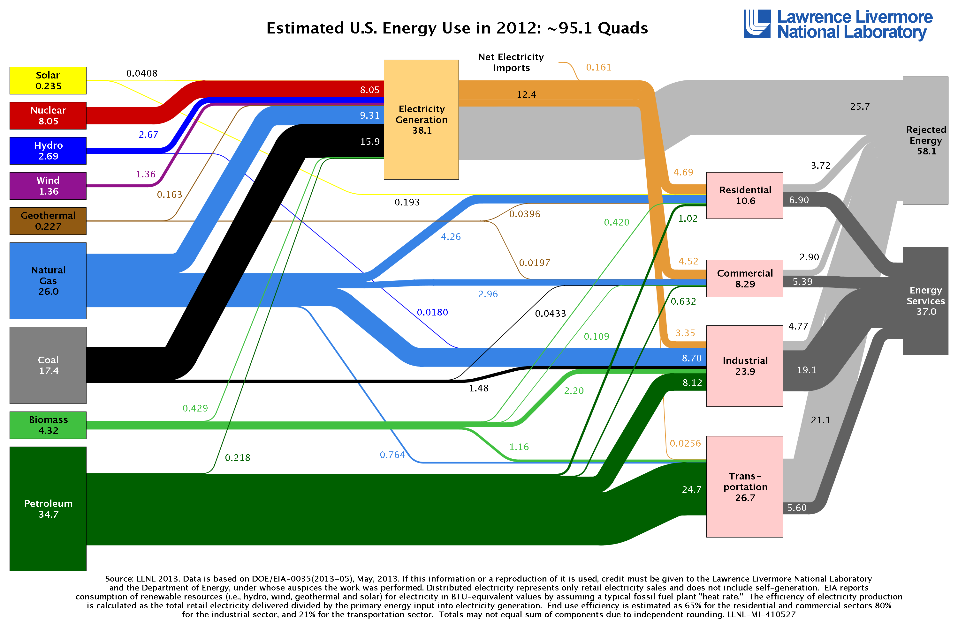
Energy Consumption

Slide 5
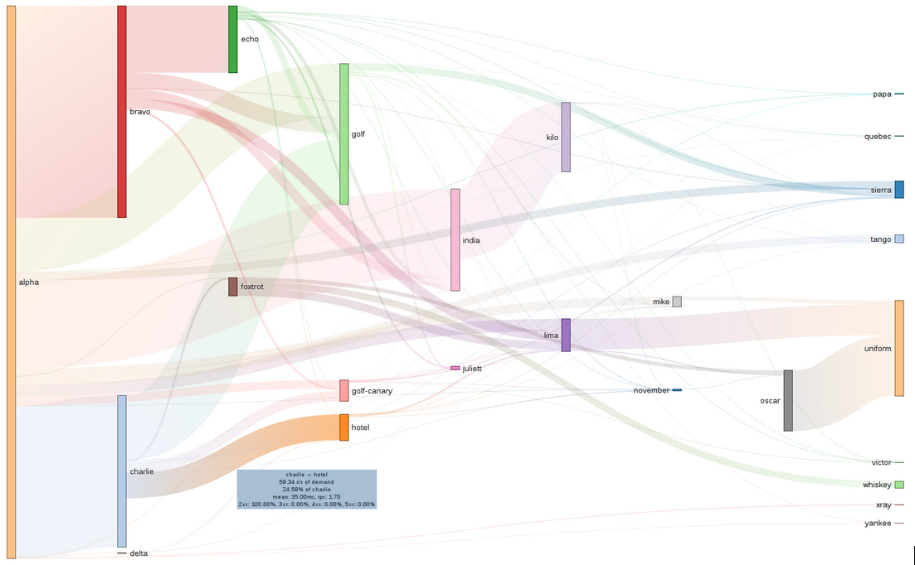
System performance bottleneck
This high-level overview gives a general picture of all the distributed services that are composed to satisfy a request. The height of each service node shows the amount of demand on that service, with the outgoing links showing demand on a downstream service relative to its siblings.

Slide 6
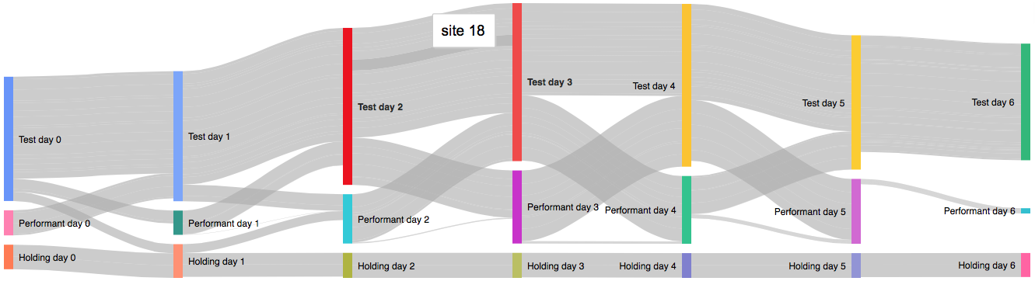
Ads placement test

Slide 7
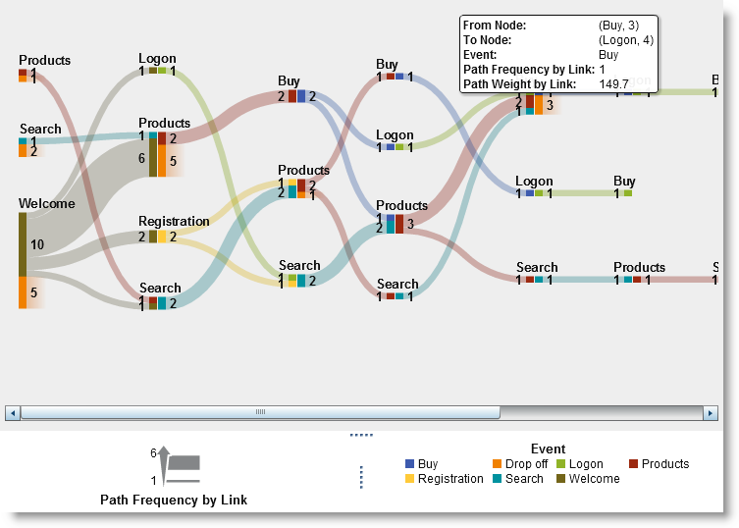
Web analytics

Slide 8
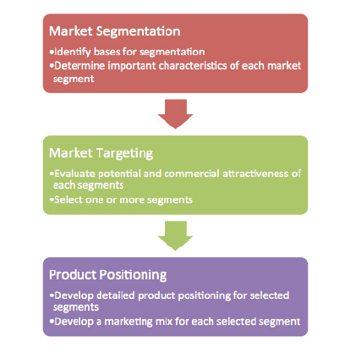

Other usages?
One example where sankey graph can be used: http://www.optimove.com/blog/managing-infinite-customer-journeys

